Slide 1

Payroll Management System
Course: PGDCA | Semester: 2nd | Roll No: 24GCA21
Developed by Sameer Ahmed under Prof. M. Nazir's mentorship.

Slide 2
Table of Contents
Employee Payroll Management System Overview
Technologies Used & Custom Modules
Login System & Role-Based Access Control
Employee Management Module (Admin Only)
ER Diagram
Tables & Fields
Integrated Calculator & Search Features
Salary Generation & Receipt
SQL Lite Integration
Employee Access & Restrictions
Testing
Conclusion And Future Scope

Slide 3
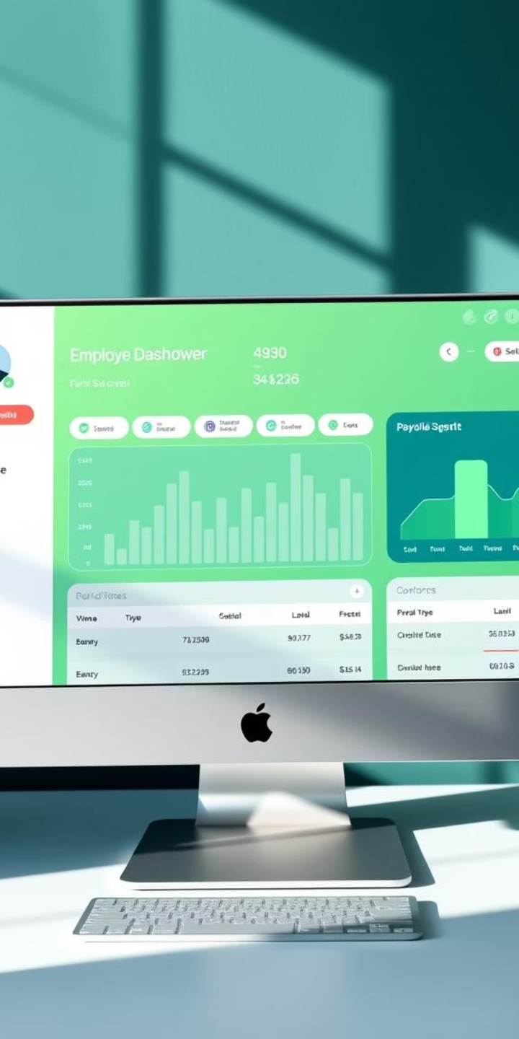
Employee Payroll Management System Overview
The Employee Payroll Management System is a desktop-based solution designed to efficiently manage employee information alongside salary records. It supports role-based access, ensuring that Admins have full control while Employees have limited, secure access to their salary details.
The system utilizes Python's Tkinter for an intuitive tabbed user interface, and SQLite serves as a robust backend database to store data securely. This combination offers a balance of simplicity, reliability, and security for payroll management.

Slide 4

Technologies Used & Custom Modules
Core Technologies
Python 3.x for development
Tkinter for graphical user interface
SQLite for database management
hashlib for password hashing
ReportLab for creating PDF
Custom Modules
login — handles authentication and access control
receipt — generates salary receipts
calculator — integrated arithmetic tool
database — manages data interactions
styles — controls UI aesthetics

Slide 5
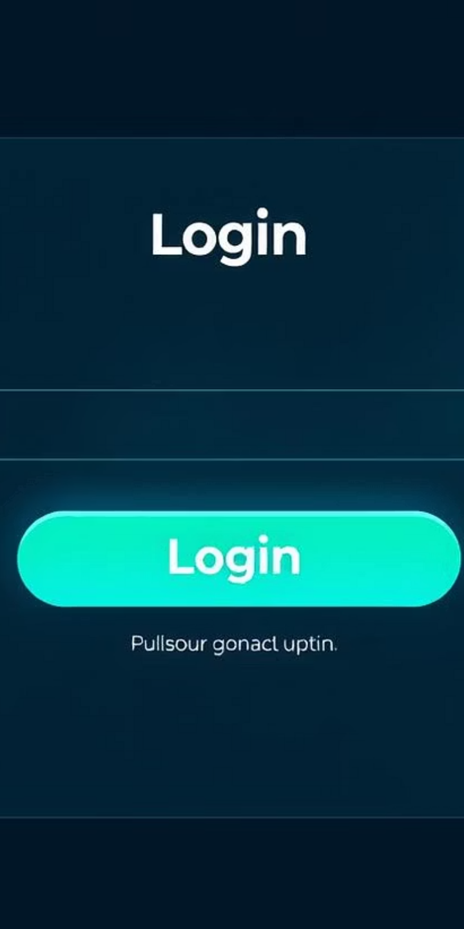


Login System & Role-Based Access Control
Login System
Authenticates users as Admin or Employee, providing secure authentication through hashed passwords.
Role-Based Access
Admin have complete control including managing employees and salaries, whereas Employees have read-only access to their own salary information and receipts.

Slide 6
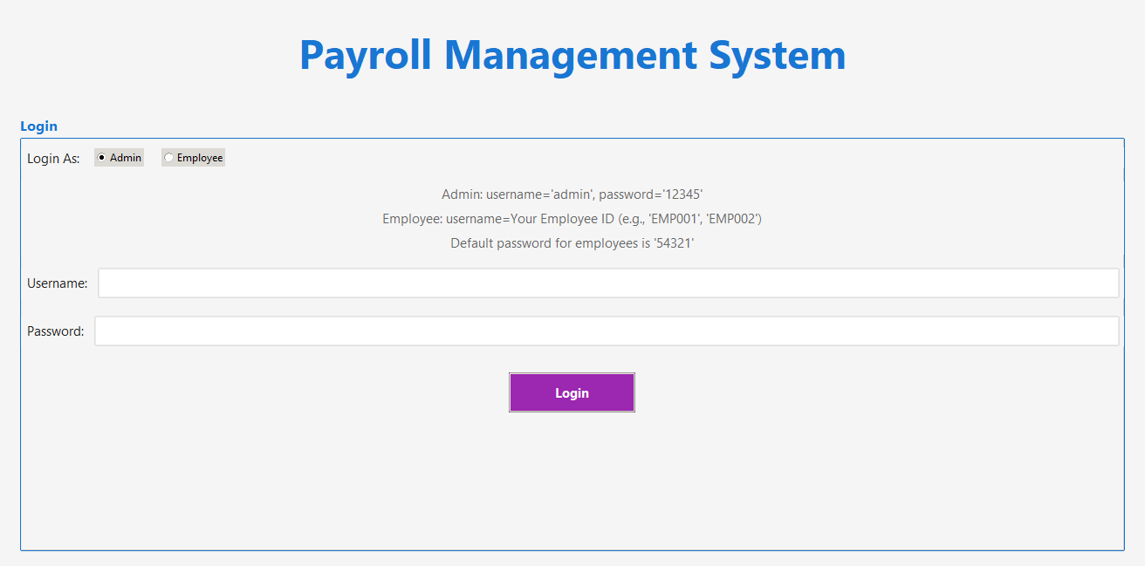

Slide 7

Employee Management Module (Admin Only)
Key Functions
Add, update, delete employee records
Search employees via multiple filters: ID, Name, Department, Designation
Maintain detailed employee profiles including contact and employment details
Data Fields
Employee ID, Name, Email, Phone
Address, Gender, Department, Designation
Date of Joining, Securely Hashed Password

Slide 8
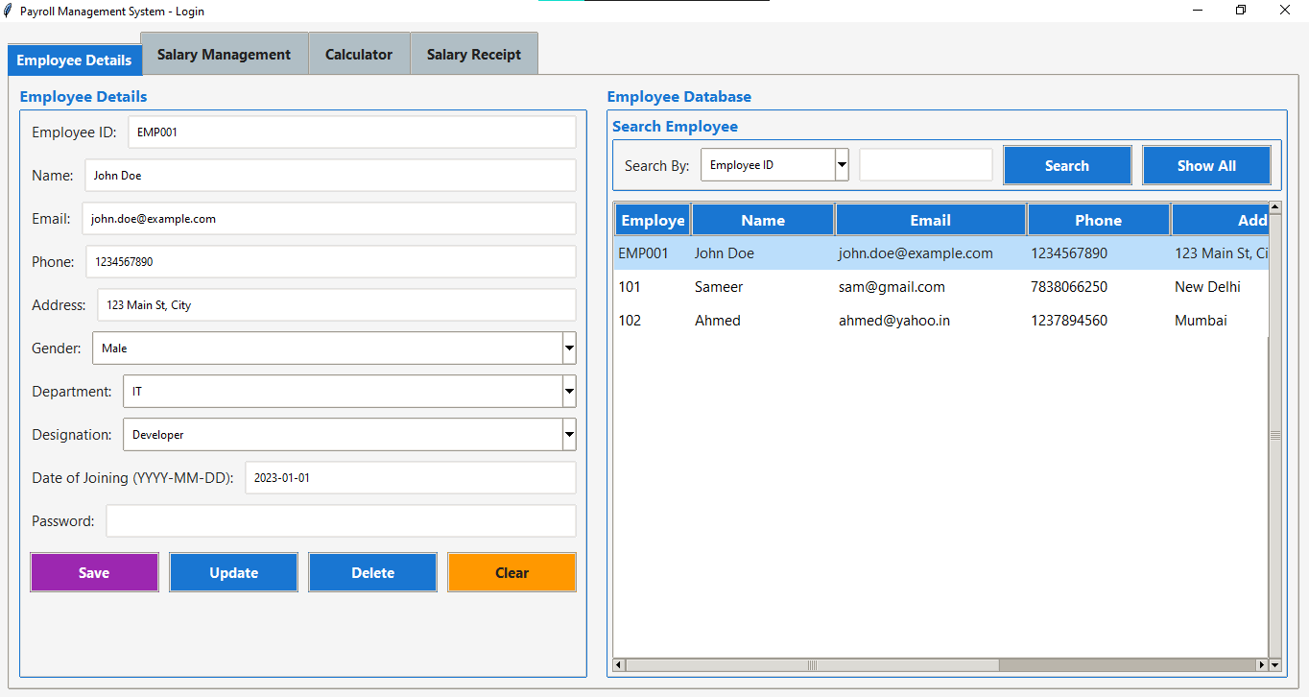

Slide 9
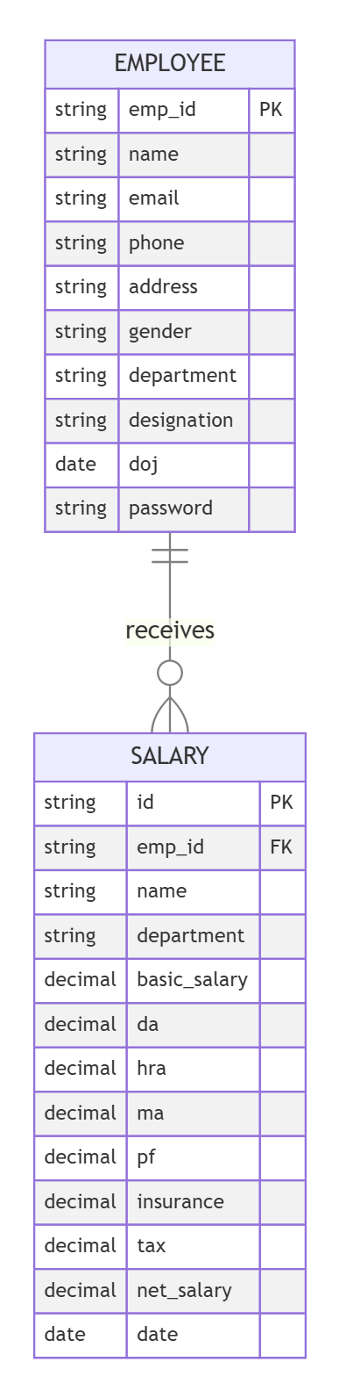
ER Diagram
The relationship between Employee and Salary is one-to-many, meaning one employee can have multiple salary records corresponding to different time periods. This relationship is enforced through the emp id foreign key in the salary table

Slide 10
Tables & Fields
Employee Table
Salary Table
Field Name |  | Data Type | Description
emp_id (PK) |  | TEXT | Primary Key, unique identifier for employee
name |  | TEXT | Full name of the employee
email |  | TEXT | Email address
phone |  | TEXT | Contact number
address |  | TEXT | Residential address
gender |  | TEXT | Gender (Male/Female/Other)
department |  | TEXT | Department name (e.g., HR, IT, Finance)
designation |  | TEXT | Job title or role
date_of_joining |  | TEXT | Joining date of the employee
password |  | TEXT | Encrypted password (SHA-256 hashed)
Field Name | Data Type | Description
id (PK) | INTEGER | Auto-incremented primary key
emp_id (FK) | TEXT | Foreign Key referencing employees.emp_id
name | TEXT | Redundant for quick access and display
department | TEXT | Department of the employee
basic_salary | REAL | Base salary value
da | REAL | Dearness Allowance
hra | REAL | House Rent Allowance
ma | REAL | Medical Allowance
pf | REAL | Provident Fund deduction
insurance | REAL | Health/accident insurance deduction
tax | REAL | Income Tax deduction
net_salary | REAL | Final salary after deductions
date | TEXT | Date of salary generation

Slide 11


Integrated Calculator & Search Features
Built-in Calculator
Advanced Search
Allows users to perform arithmetic operations without leaving the system, enhancing productivity.
Admins can quickly locate employee records with filters such as ID, Name, Department, or Designation.

Slide 12
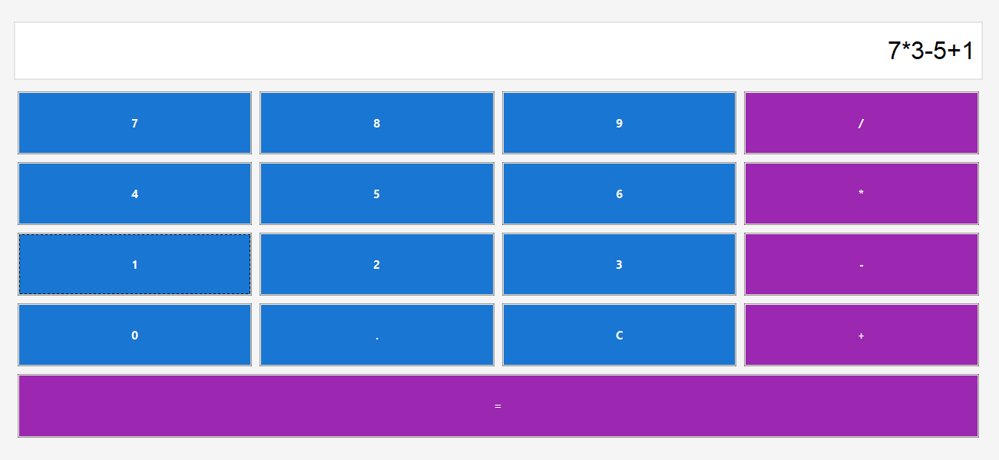

Slide 13
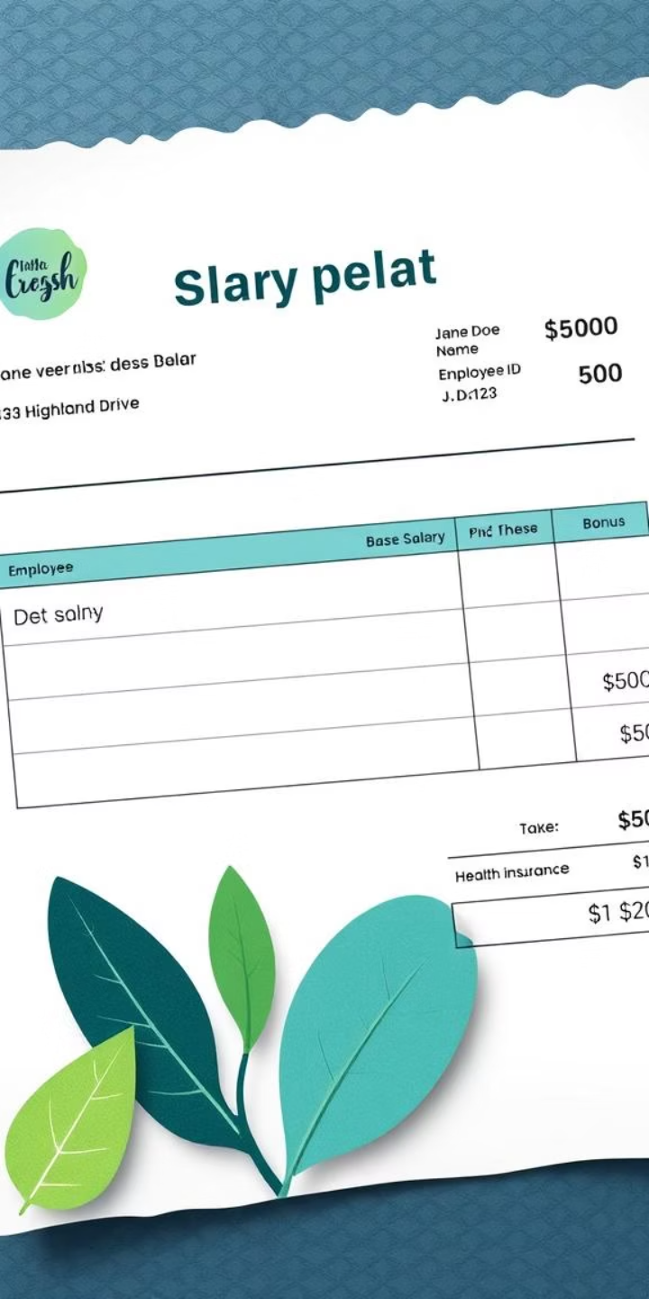



Automated Salary Generation & Receipt
Net Salary Calculation
Automatically computed using formula: (Basic + DA + HRA + MA) - (PF + Insurance + Tax).
Receipt Generation
Printable and viewable salary receipts provide transparency and record-keeping for employees.
Receipt Format
Flexible options for exporting salary receipt in the format of .TXT or .PDF Files.

Slide 14
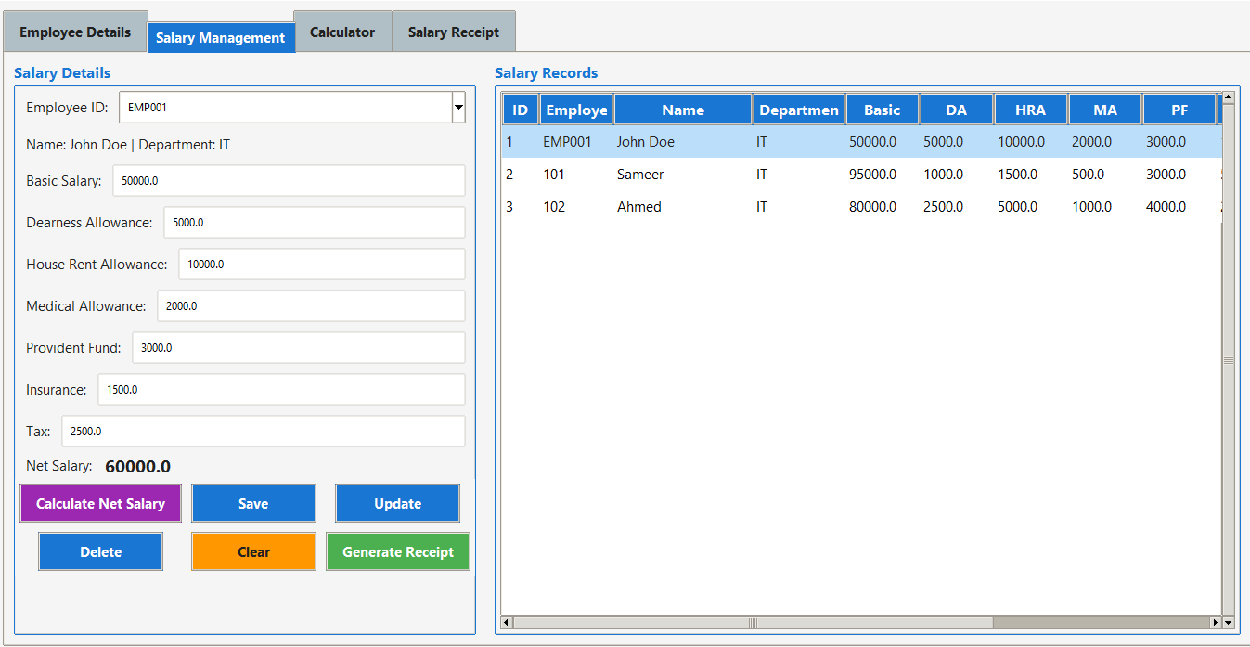
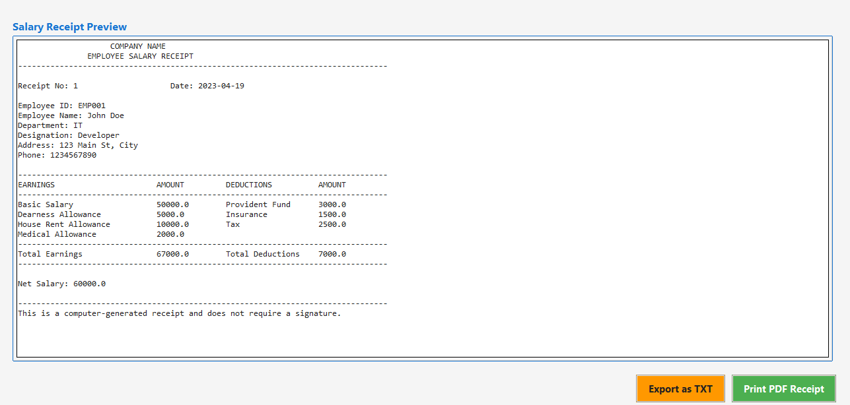

Slide 15
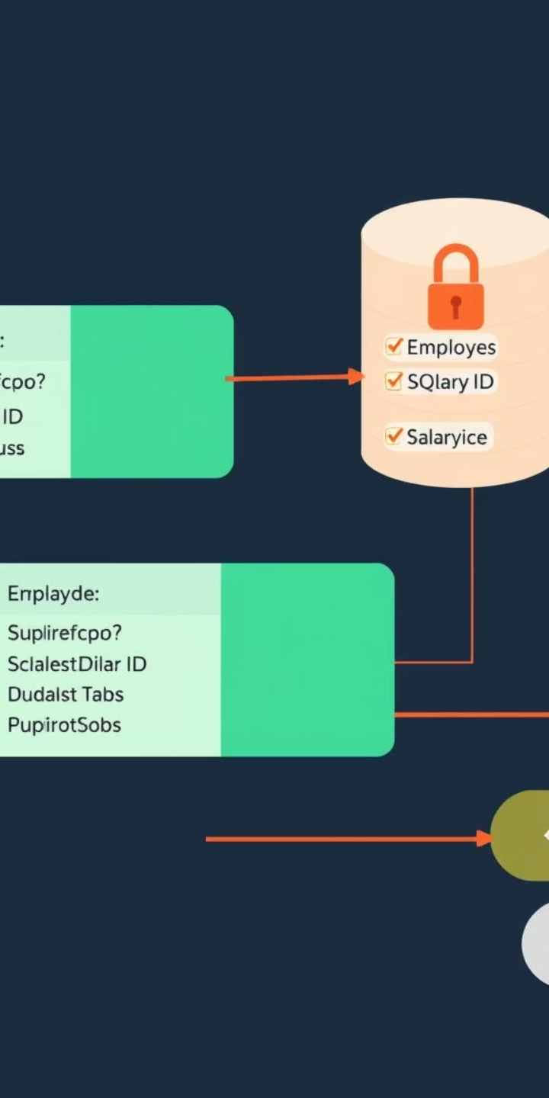



Secure Database Integration with SQLite
Data Storage
Security Measures
Employee and salary data are securely stored in an SQLite database ensuring efficient access and updates.
Prepared SQL queries prevent injection attacks, and password hashing protects user credentials.
Reliability
SQLite provides lightweight, serverless, and transactional database management suitable for desktop apps.

Slide 16
Testing
Test Case | Input |  | Expected Output | Pass/Fail
Login with valid admin credentials | Username: admin, Password: 12345 |  | Access granted, admin dashboard loads | Pass
Login with invalid password | Username: admin, Password: xyz |  | Access denied, error message shown | Pass
Add new employee | Emp ID: E001, Name: John Doe |  | Employee record saved and displayed | Pass
Generate salary receipt | Basic: 30000, DA: 5000, Deductions: 2000 |  | PDF receipt generated correctly | Pass

Slide 17
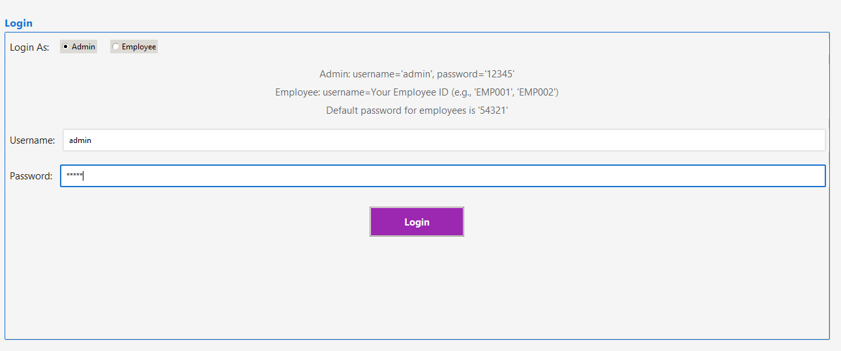
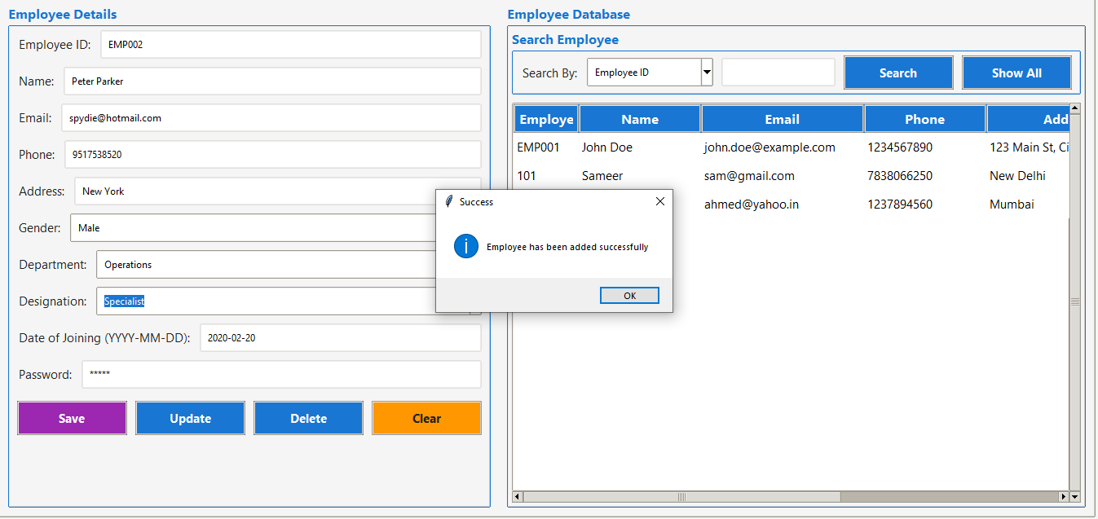
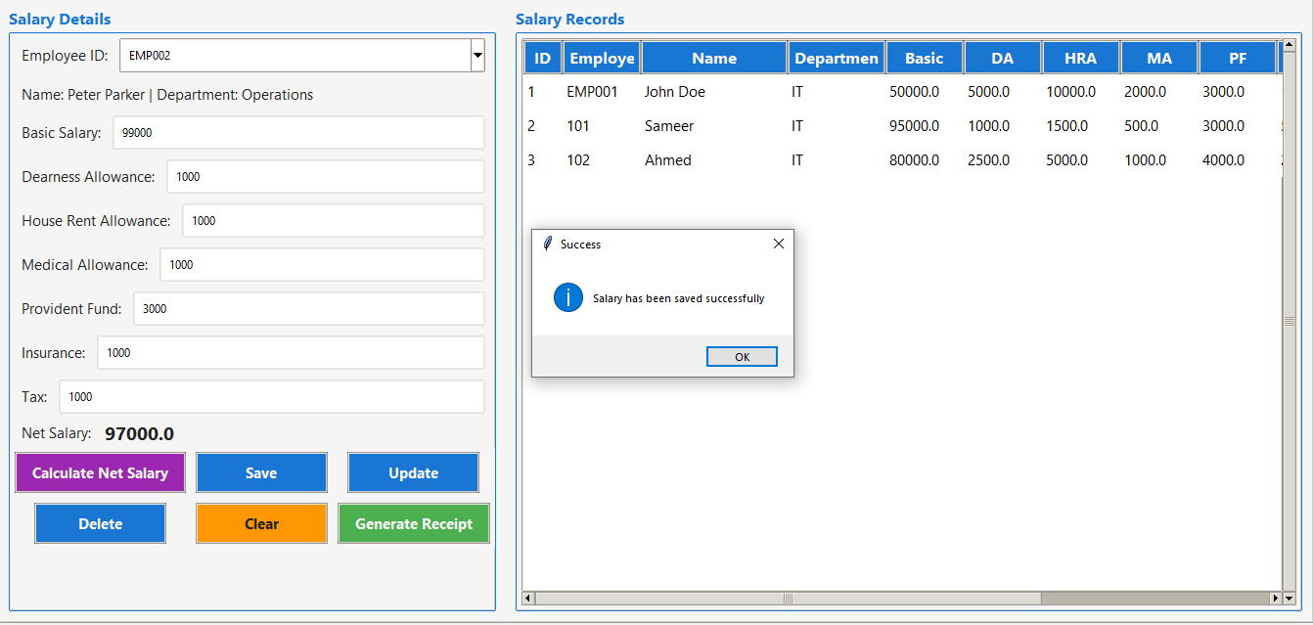
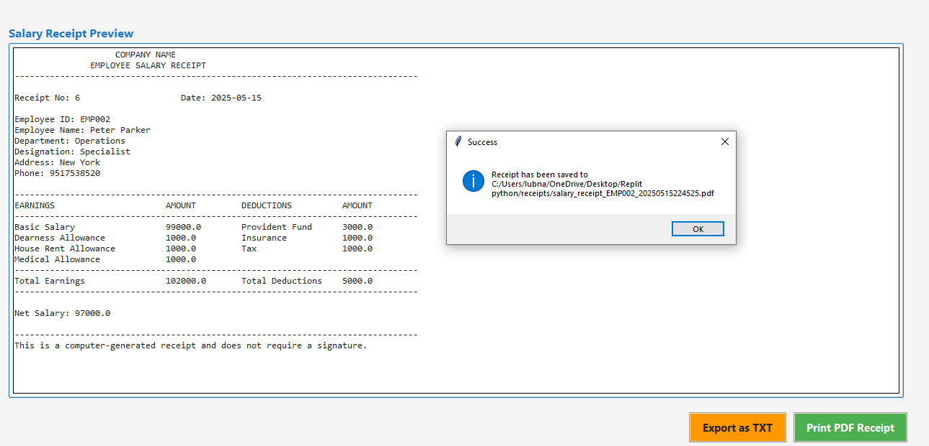

Slide 18

Employee Access & Restrictions
Employee Accessible Features
Employee Restrictions
View own salary records and net salary
No access to manage employee or salary records
Download salary receipts
Cannot view other employees' data
Use built-in calculator module
Edit functions are disabled for Employees

Slide 19
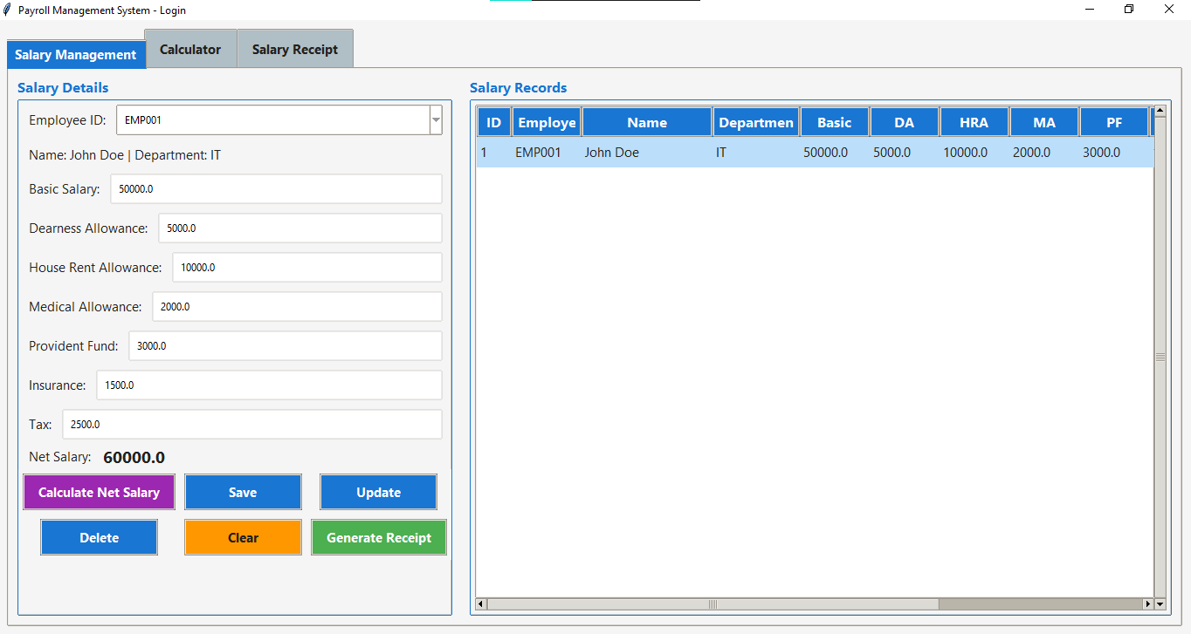

Slide 20
Conclusion
The Employee Payroll Management System successfully fulfils its core objective of automating the payroll process while maintaining high standards of accuracy, efficiency, and usability. The system brings together critical functionalities—such as employee record management, salary computation, salary slip generation, and even a built-in calculator—into a unified platform that is both robust and user-friendly.
Future Scope
Role-Based Access Control (RBAC): Introduce more granular roles such as HR Manager, Finance Officer, and Employee, each with customized permissions and access levels.
Employee Attendance Integration: Link the system to attendance tracking modules or biometric systems so that salaries are calculated based on actual days worked, overtime, or leaves.
Database Migration: Move from SQLite to MySQL, PostgreSQL, or a cloud-based solution like Firebase or AWS RDS to support concurrent users and high-volume data storage.

Slide 21
THANK YOU

